Slide 1
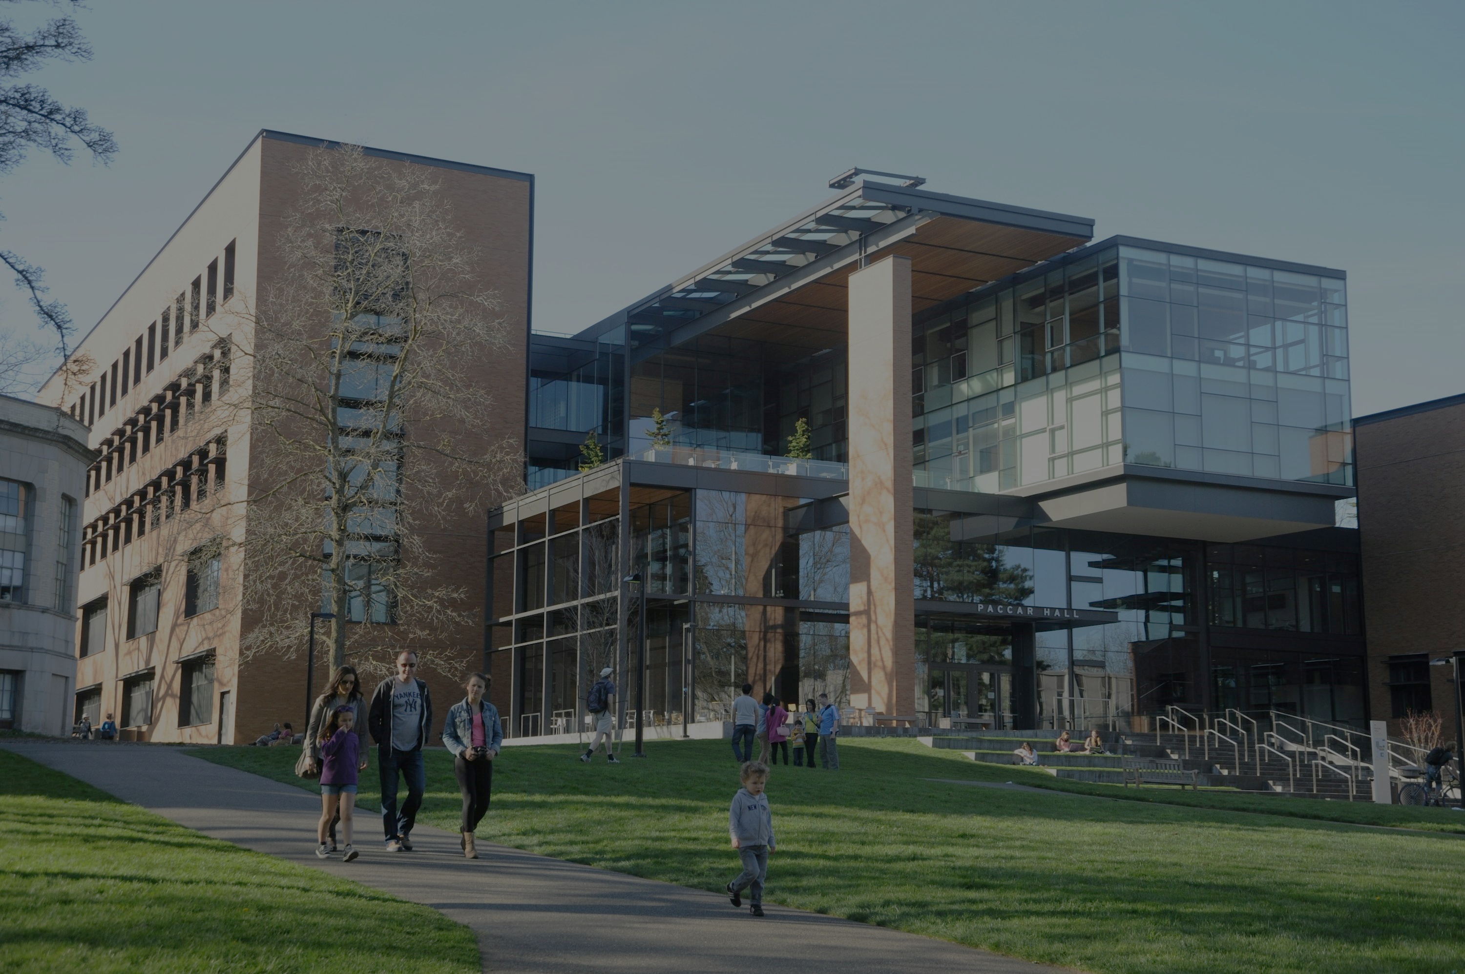
校園故事
Notes:
https://unsplash.com/photos/people-walking-near-paccar-hall-university-of-washington-during-daytime-6zlgM-GUd6I

Slide 2
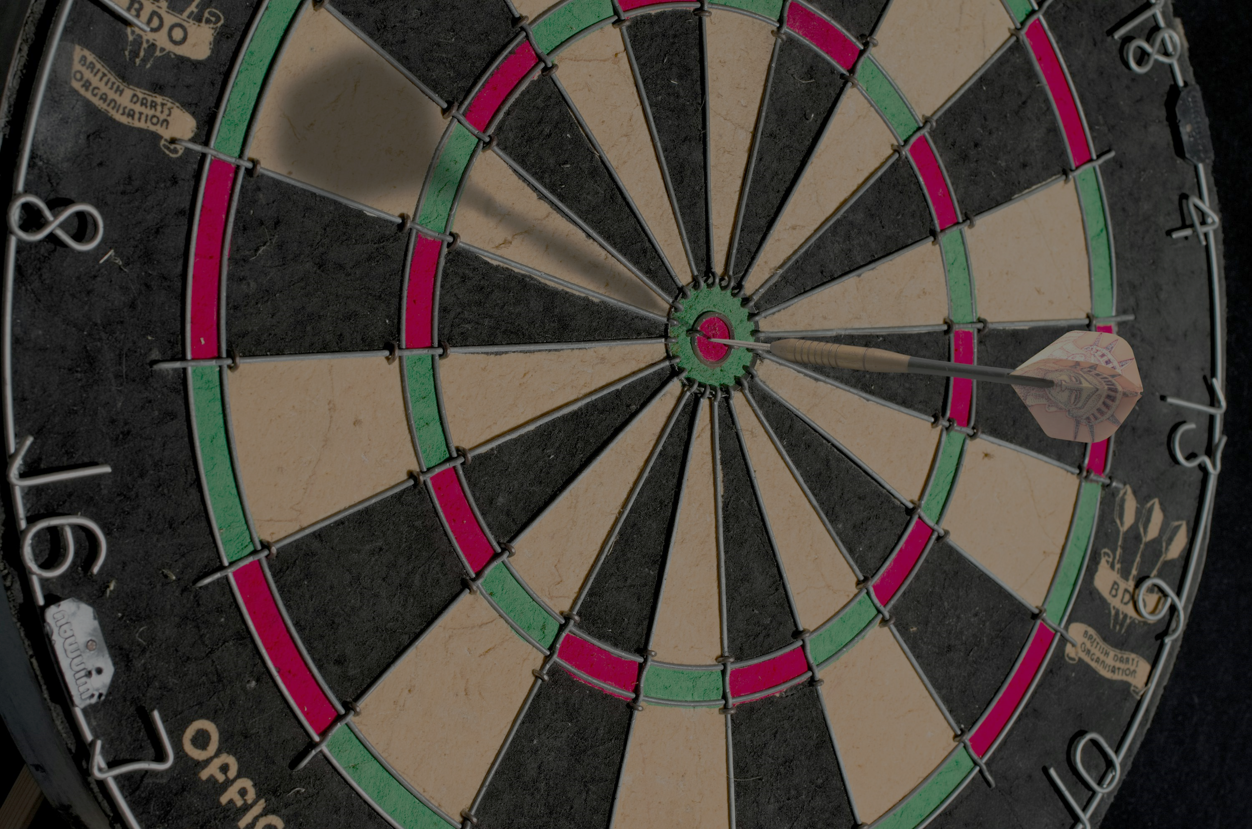
1. 目標
Notes:
https://unsplash.com/photos/brown-and-black-round-board-DX3_dXuHVl

Slide 3

Notes:
https://unsplash.com/photos/black-digital-camera-capturing-yellow-flower-qWYvQMIJyfE

Slide 4
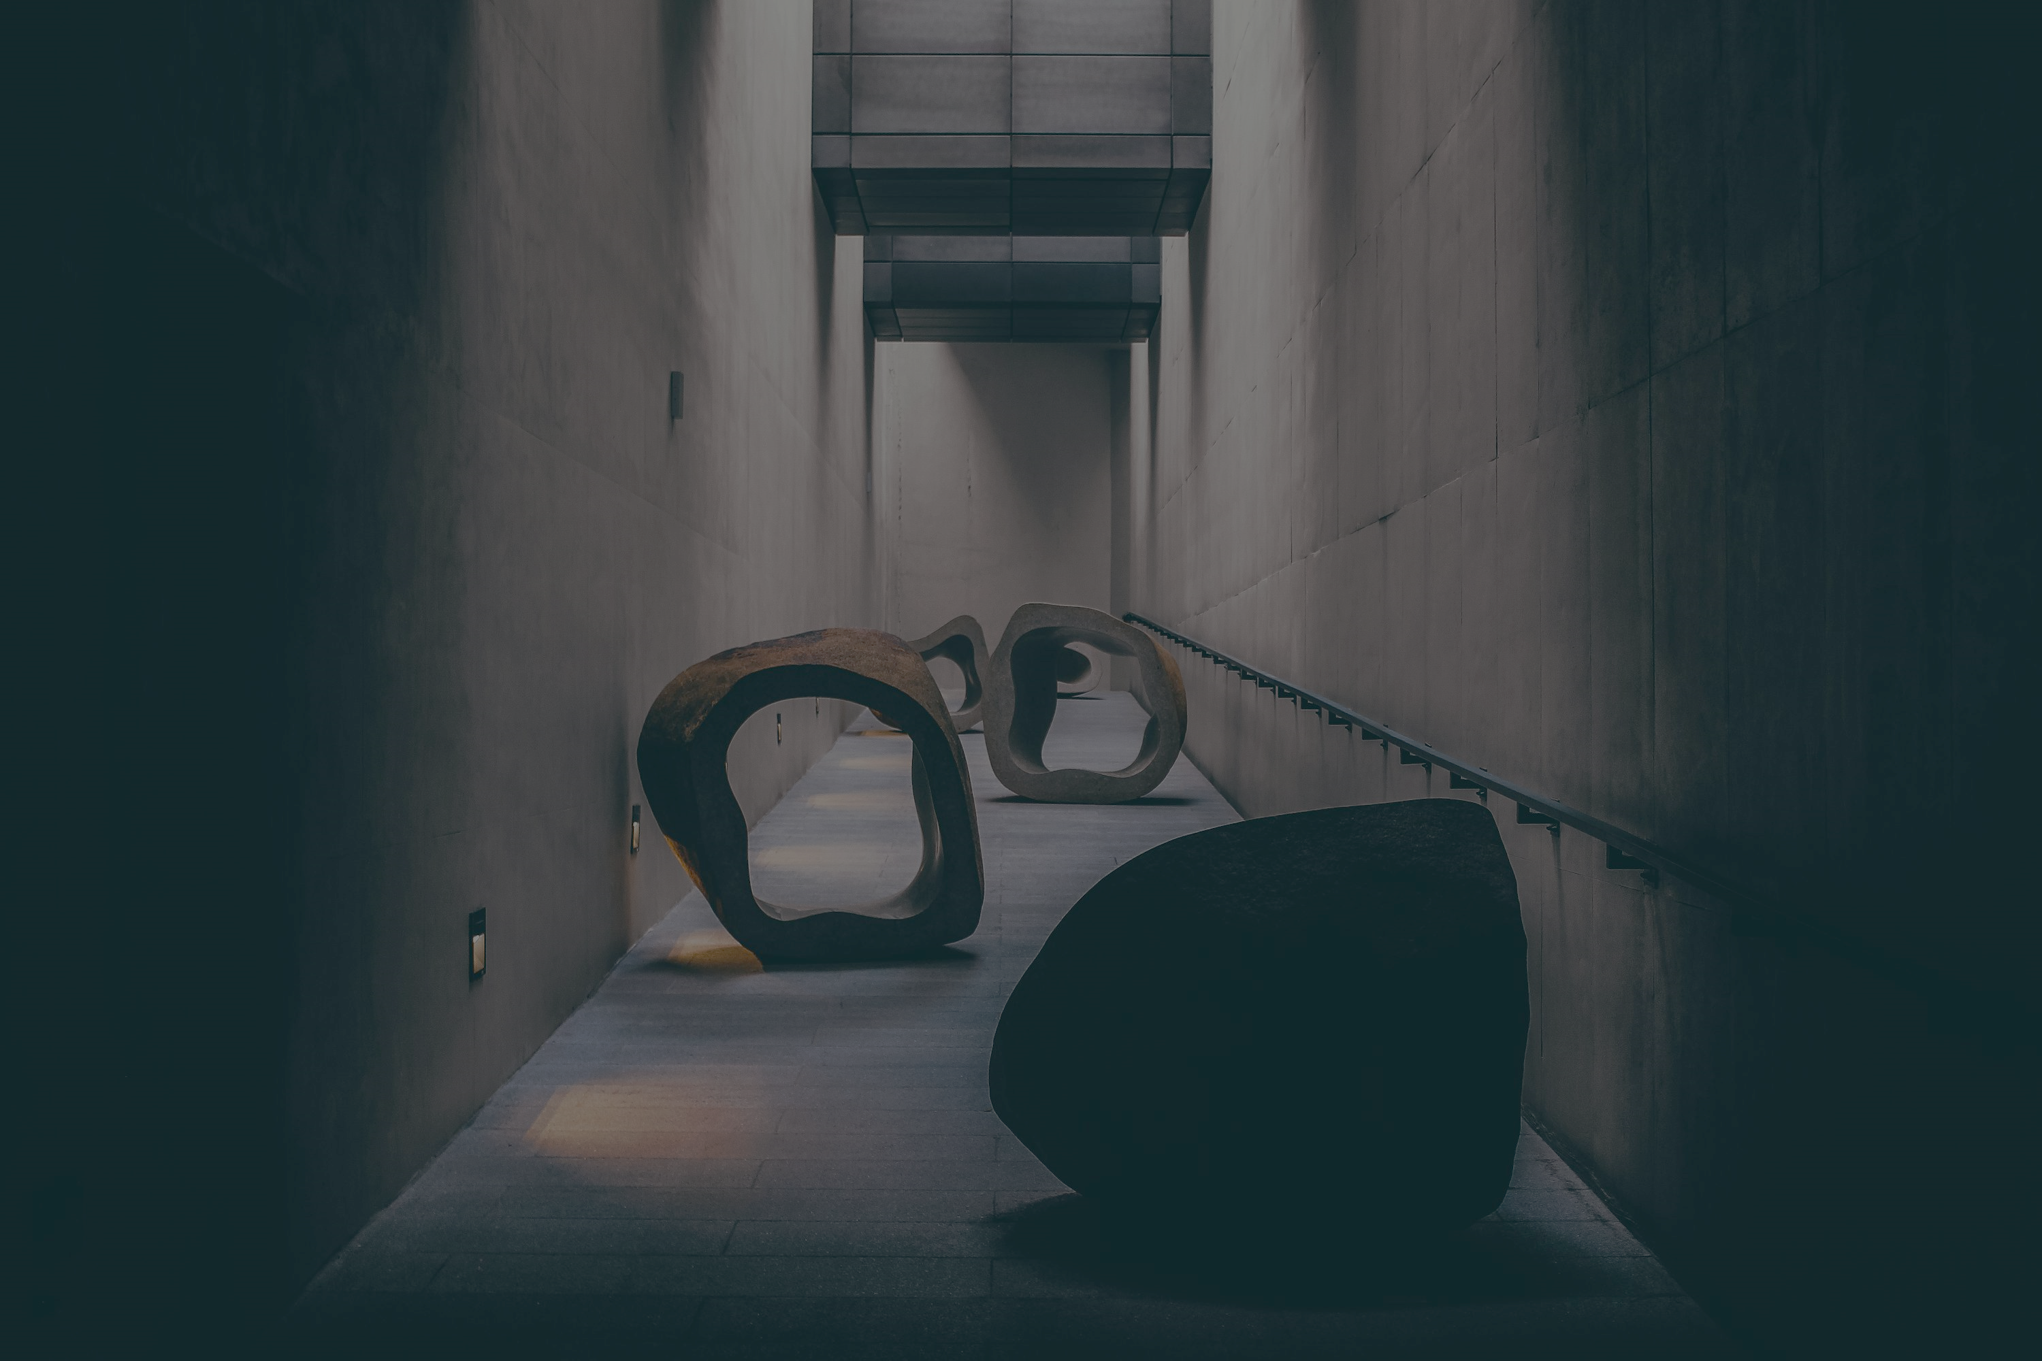
2. 阻礙
Notes:
https://unsplash.com/photos/a-couple-of-large-sculptures-sitting-on-top-of-a-cement-floor-g4xIcepnx6I

Slide 5
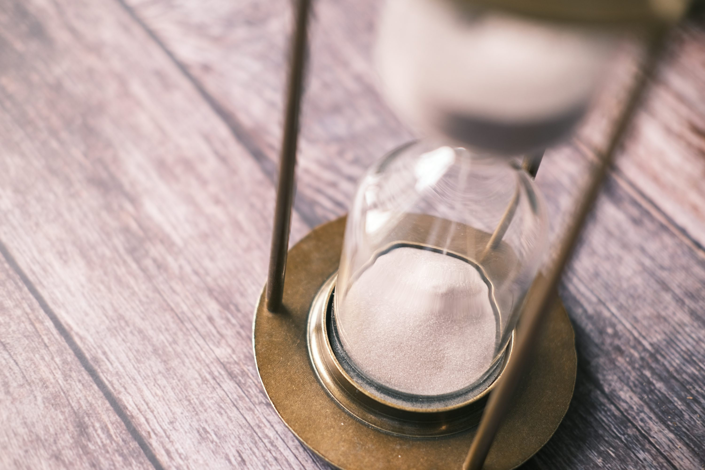
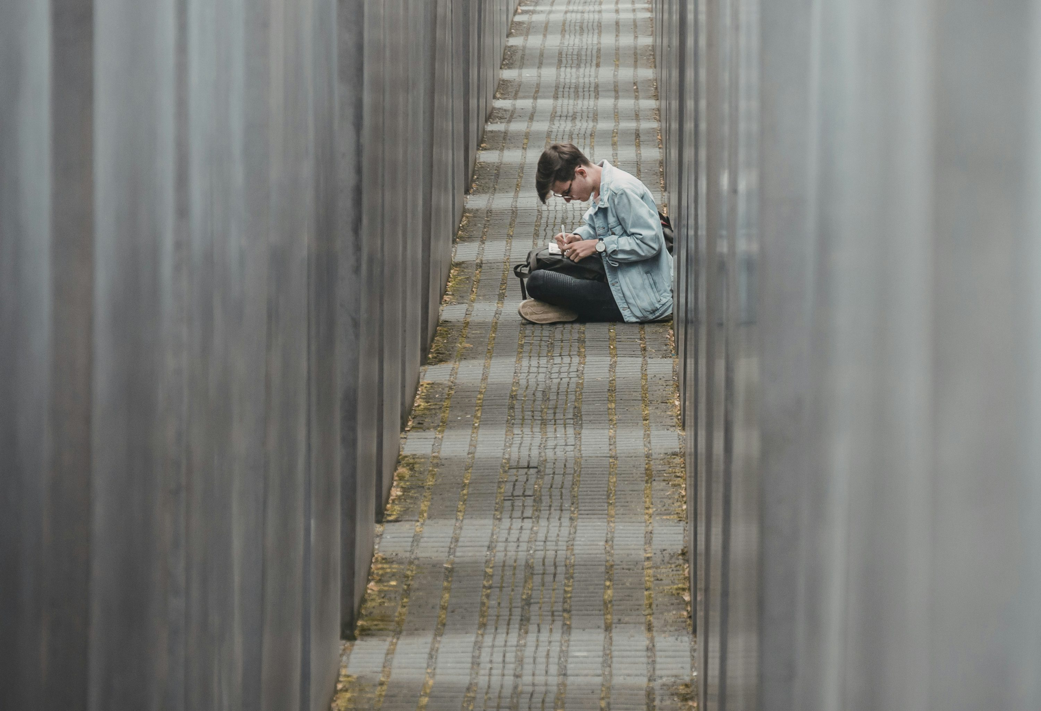
Notes:
https://unsplash.com/photos/an-hourglass-sitting-on-top-of-a-wooden-table-Cv1IZqKJQzU
https://unsplash.com/photos/man-sitting-on-pathway-writing-on-paper-OOons69iI-k

Slide 6
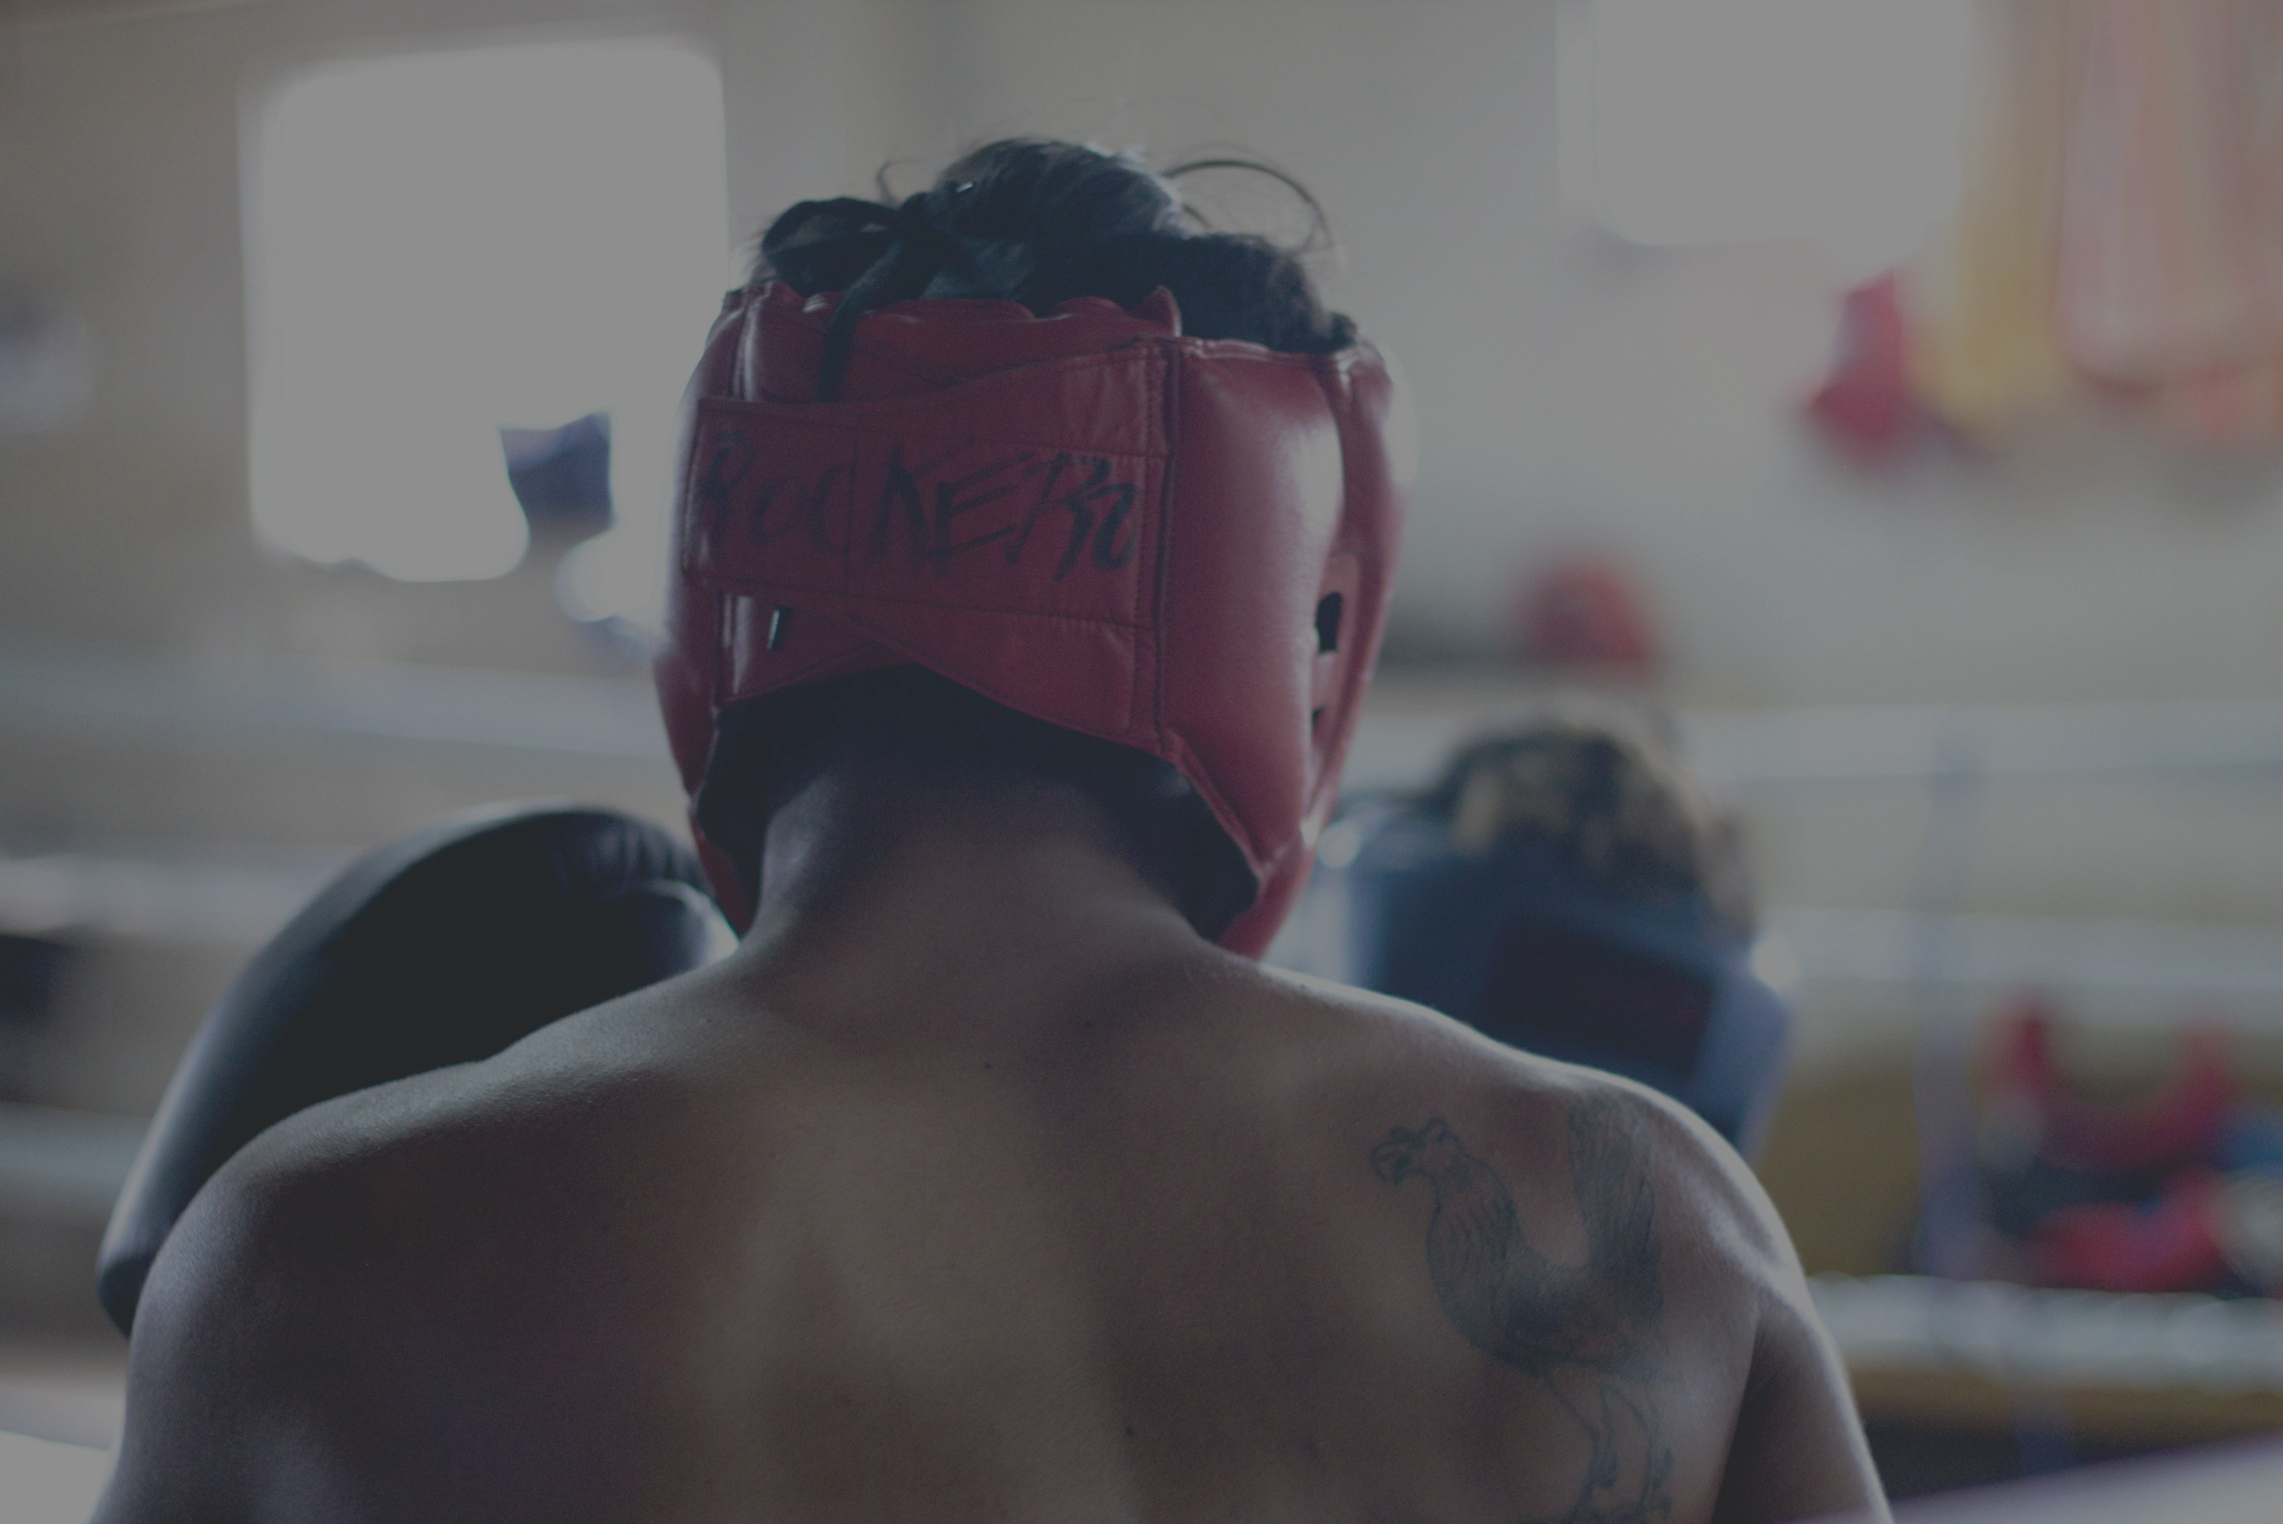
3.努力
Notes:
https://unsplash.com/photos/man-wearing-red-head-protector-and-gloves-dBnrs5XYTrs

Slide 7
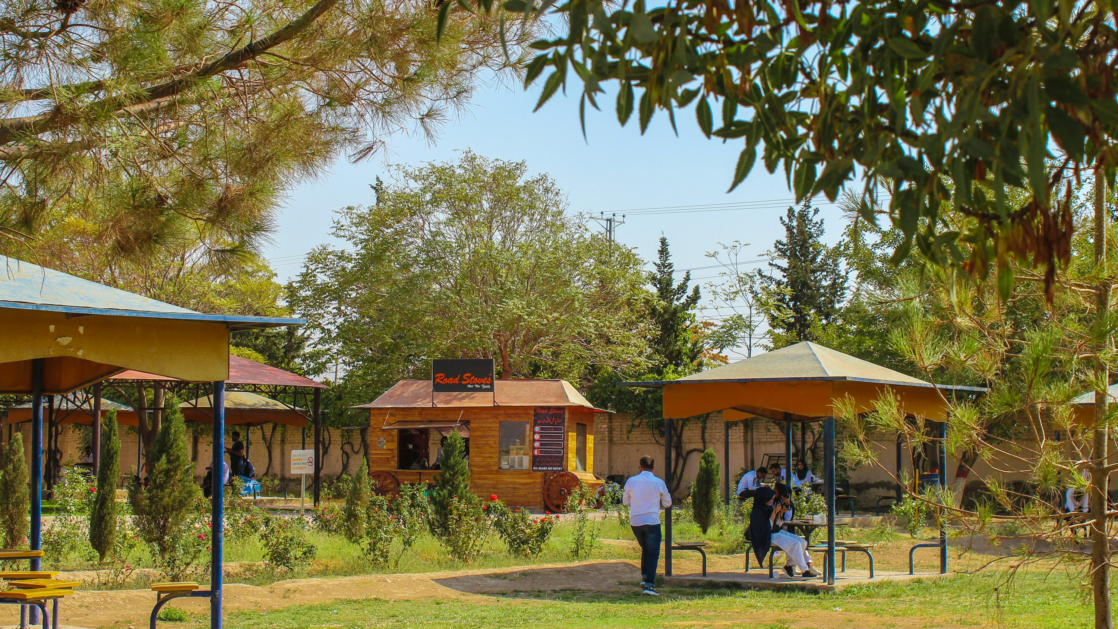
Notes:
https://unsplash.com/photos/a-group-of-people-walking-around-a-park-zL76QzAFKQE

Slide 8
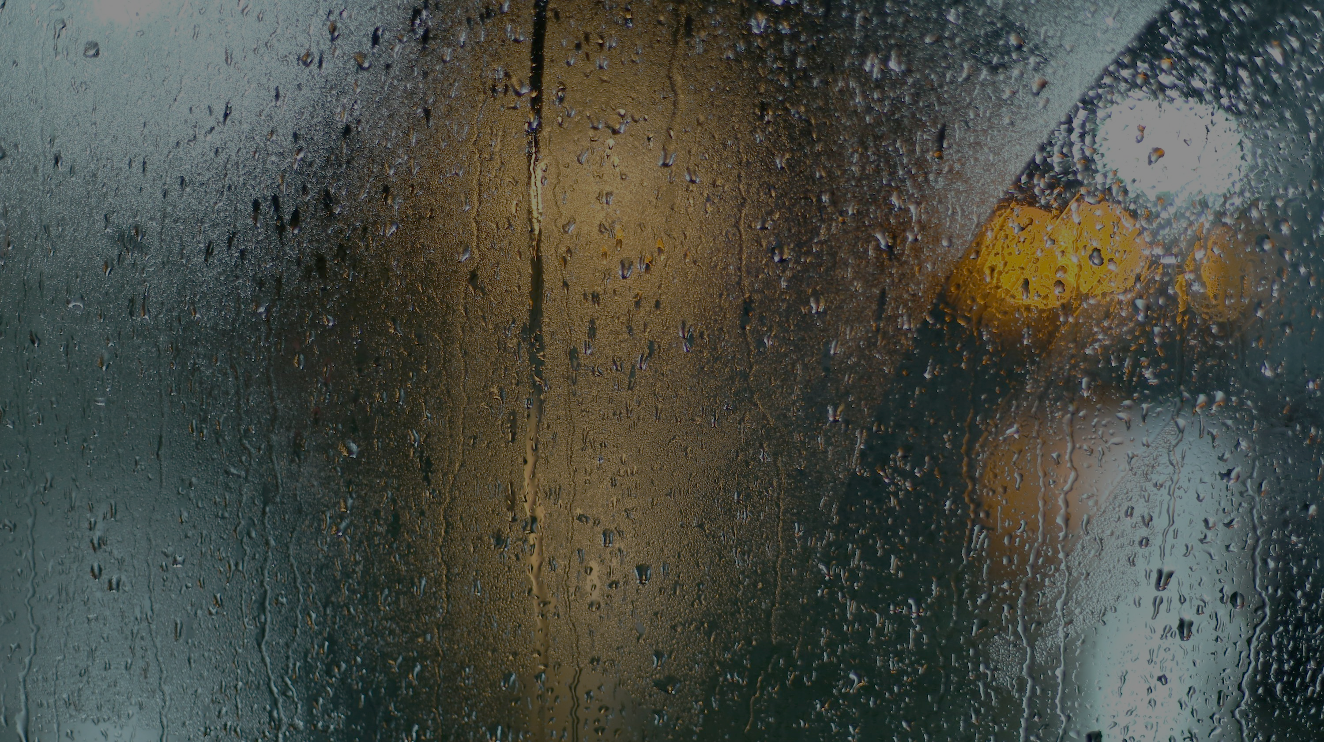
4.結果
Notes:
https://unsplash.com/photos/a-wet-window-with-a-traffic-light-on-it-JgDUVGAXsso

Slide 9


Notes:
https://unsplash.com/photos/photo-of-library-with-turned-on-lights-sfL_QOnmy00
https://unsplash.com/photos/macbook-pro-on-top-of-brown-table-1SAnrIxw5OY

Slide 10
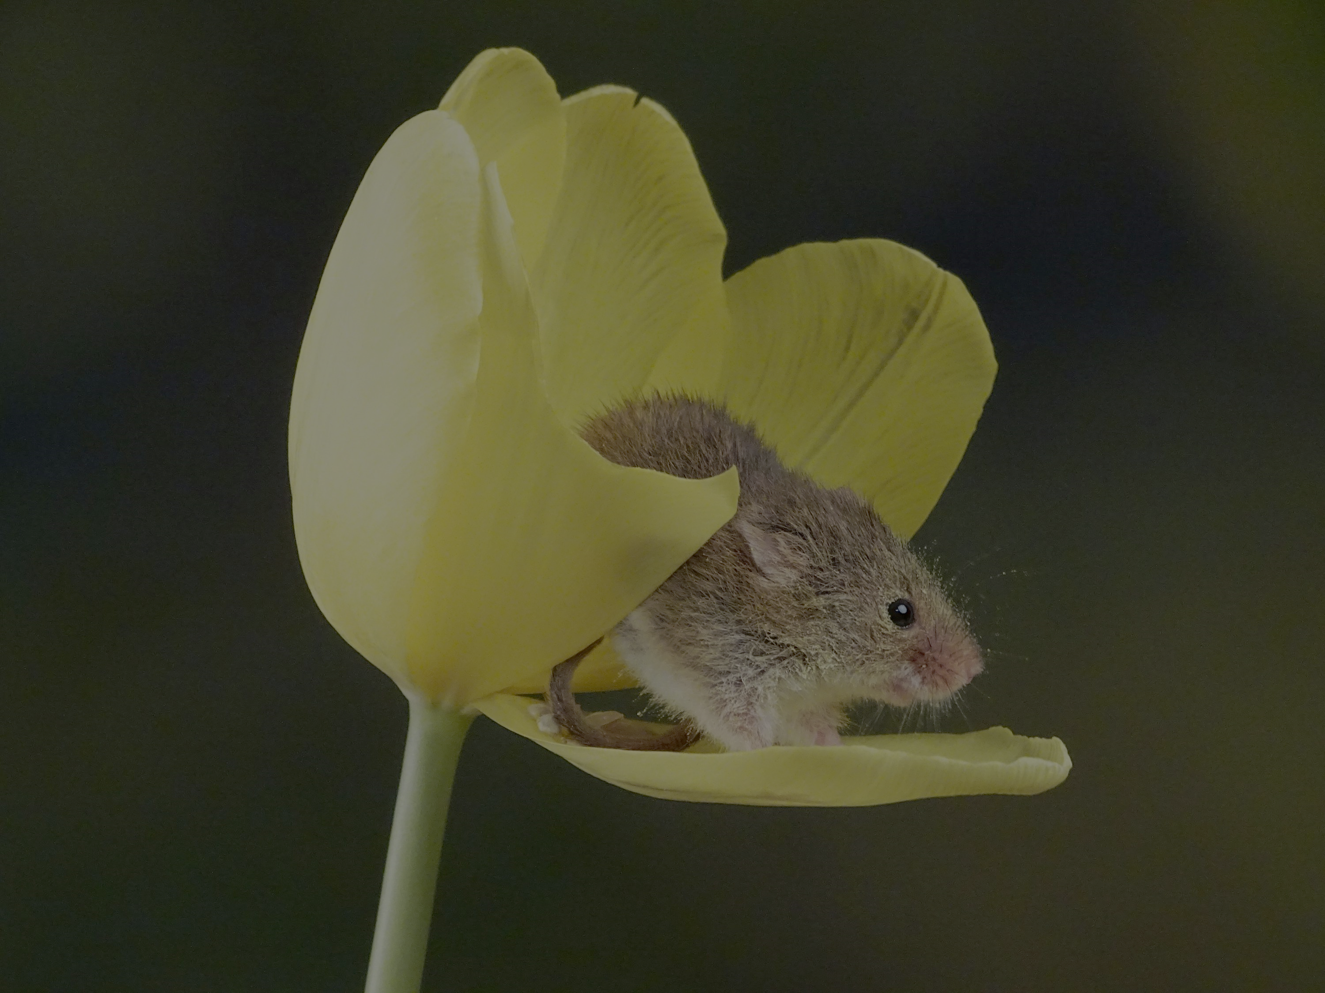
5.意外
Notes:
https://unsplash.com/photos/brown-rodent-on-yellow-flower-C3XJkio_Osc

Slide 11

Notes:
https://unsplash.com/photos/people-running-on-grassfield-under-blue-skies-at-daytime-AcWC8WuCQ_k

Slide 12
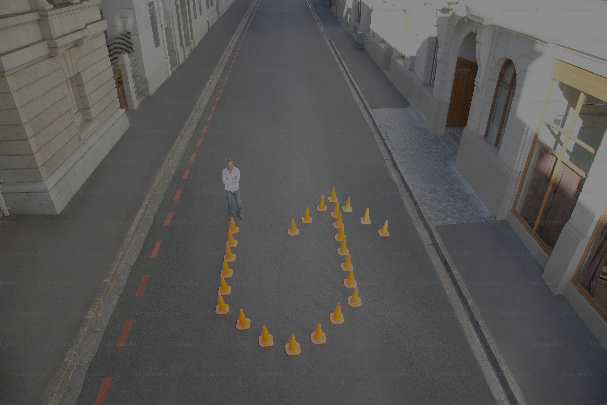
6.轉彎
Notes:
https://unsplash.com/photos/a-man-standing-in-the-middle-of-an-empty-street-9F3C_8Zgiuw

Slide 13
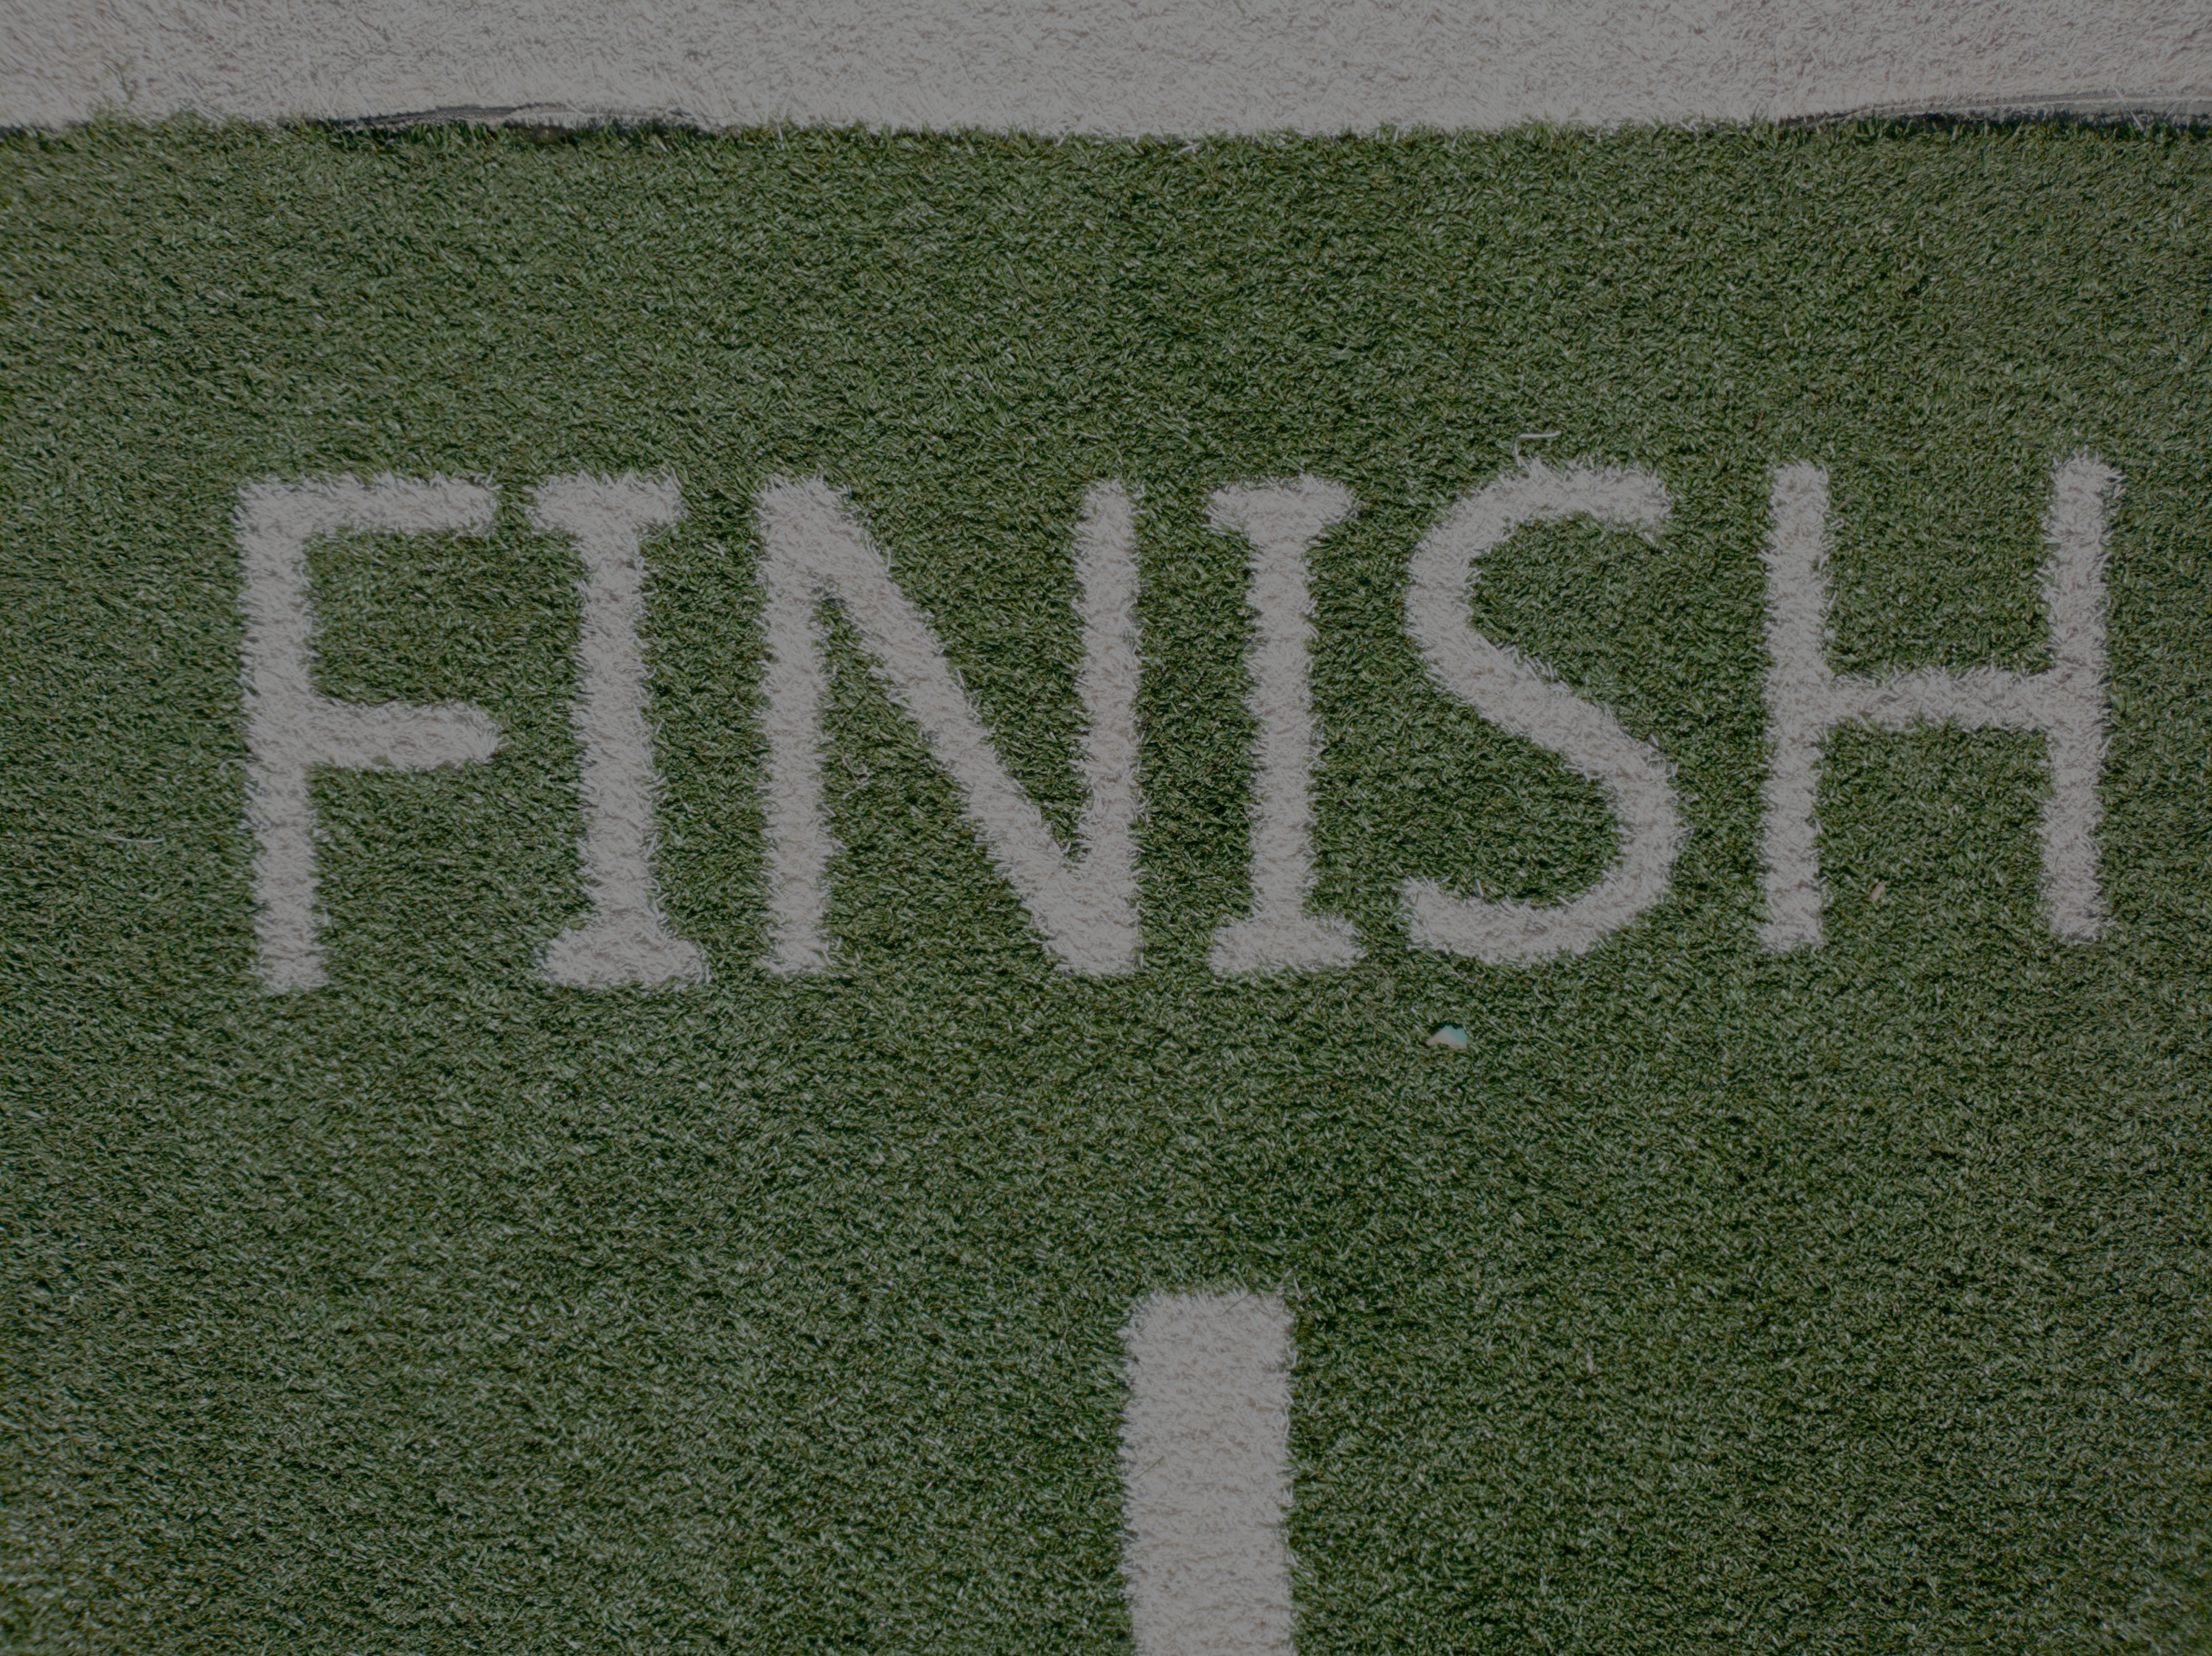
7.結局
Notes:
https://unsplash.com/photos/green-and-white-i-love-you-printed-textile-Nsaqv7v2V7Q

Slide 14

Notes:
https://unsplash.com/photos/yellow-and-white-trophy-_XTY6lD8jgM

Slide 15

Notes:
https://unsplash.com/photos/person-holding-thanks-card-SNMKcGFB-0w

